Slide 1
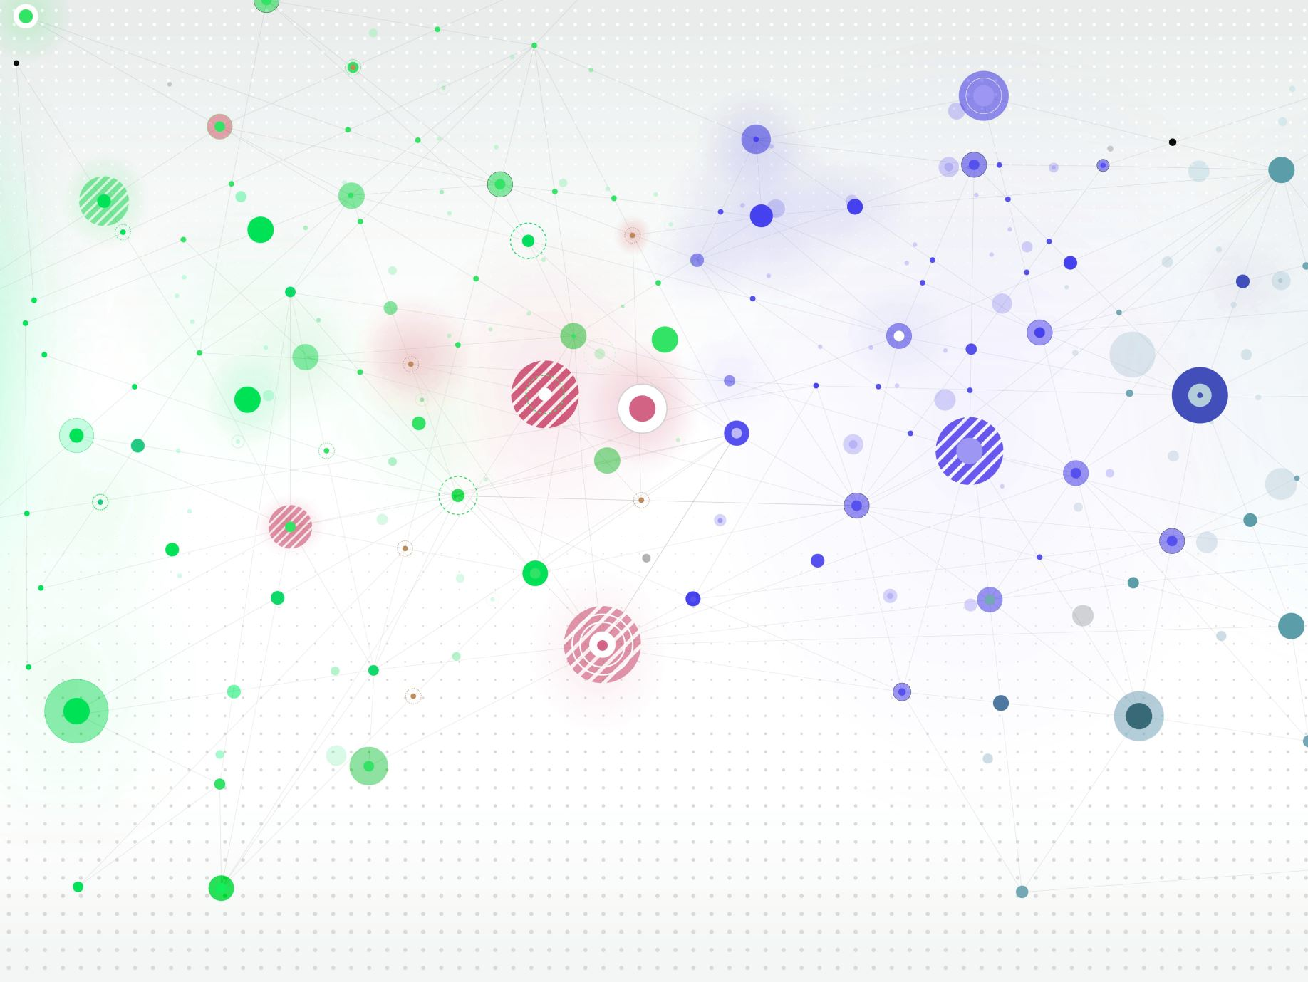
The Transformative Impact of Large Language Models (LLMs) on Healthcare Data Management
Nasser Al-Naimi
MSc Computer Science
Research Methods and Professional Practice
May 20, 2024
Notes:
Good morning, everyone. My name is Nasser Al-Naimi, and today I will be presenting my research proposal on 'The Transformative Impact of Large Language Models on Healthcare Data Management.' This presentation is part of my coursework for Research Methods and Professional Practice, and I look forward to discussing how advancements in AI, particularly Large Language Models, are revolutionizing the way we manage healthcare data.

Slide 2
Introduction
Overview of the Research Proposal
Significance of Large Language Models (LLMs) in Healthcare
Data complexity and volume challenges
Potential benefits of LLMs
Research Focus Areas
Predictive analytics
Patient data processing
Clinical decision-making
Notes:
This presentation will overview my research proposal on Large Language Models (LLMs) in healthcare. We'll explore how LLMs enhance predictive analytics, patient data processing, and clinical decision-making, aiming to improve patient outcomes and healthcare delivery.
LLMs are crucial for handling the large and complex data in healthcare. Hospitals generate vast amounts of patient data daily that need efficient management and analysis.
By leveraging LLMs, healthcare providers can gain valuable insights for better predictive analytics, streamlined data processing, and enhanced decision-making, leading to improved patient outcomes, reduced costs, and greater efficiency.
We will focus on three areas: predictive analytics, patient data processing, and clinical decision-making, to demonstrate the transformative impact of LLMs.

Slide 3
Significance/Contribution to the Discipline/Research Problem
Significance:
How LLMs are transforming healthcare data management
Improved data processing and insights
Enhanced decision-making capabilities
Contribution:
Benefits to the healthcare industry
Potential to reduce costs and improve patient outcomes
Streamlining administrative tasks
Research Problem:
Challenges in managing vast amounts of healthcare data
Issues of data privacy and security
Integration of LLMs with existing healthcare systems
Notes:
In this slide, I will discuss the significance of Large Language Models (LLMs) in healthcare, their contribution to the discipline, and the specific research problems this proposal aims to address.
Significance: LLMs transform healthcare data management by providing advanced tools for processing and analyzing large amounts of unstructured data. These models improve clinical decision-making and patient care by extracting valuable insights from complex datasets.
Contribution: The integration of LLMs into healthcare systems offers numerous benefits. By automating routine data processing tasks, healthcare professionals can focus more on patient care, potentially reducing costs and improving outcomes. Additionally, LLMs can streamline administrative tasks, such as scheduling and billing, making healthcare operations more efficient.
Research Problem: Despite their potential, the adoption of LLMs in healthcare presents several challenges. Managing the vast amounts of data generated daily can be overwhelming without effective tools. Additionally, there are significant concerns regarding data privacy and security. Another challenge is the integration of LLMs with existing healthcare systems, which often require substantial modifications and updates.

Slide 4
Research Question
Main Research Question
How can Large Language Models improve healthcare data management?
Sub-questions
What are the specific benefits of using LLMs in predictive analytics?
How do LLMs enhance patient data processing and management?
What are the challenges and limitations of integrating LLMs into existing healthcare systems?
Notes:
In this slide, I will outline the main research question and sub-questions that guide this research proposal.
Main Research Question: How can Large Language Models improve healthcare data management? This question explores the impact of LLMs on the efficiency, accuracy, and effectiveness of managing healthcare data.
Sub-questions: To address the main question, we have several sub-questions:
Benefits of LLMs in predictive analytics: How can LLMs enhance the predictive capabilities of healthcare systems?
Enhancement of patient data processing and management: How do LLMs improve data retrieval, accuracy, and usability for healthcare providers?
Challenges and limitations of integrating LLMs into healthcare systems: What are the potential barriers to adopting LLMs, including technical, ethical, and organizational challenges?

Slide 5
Aims and Objectives
Aim:
To evaluate the impact of Large Language Models (LLMs) on healthcare data management
Objectives:
Analyze the current use of LLMs in healthcare data processing
Assess the benefits and challenges of integrating LLMs into healthcare systems
Develop a framework for ethical and effective implementation of LLMs in healthcare
Identify key factors that influence the adoption of LLMs in healthcare settings
Notes:
Aim: The main aim of this research is to evaluate the impact of Large Language Models (LLMs) on healthcare data management. This involves understanding how LLMs can improve data processing, predictive analytics, and decision-making in healthcare settings.
Objectives: To achieve this aim, the research will focus on the following specific objectives:
Analyze the current use of LLMs in healthcare data processing: Examine existing applications of LLMs, best practices, and the current landscape.
Assess the benefits and challenges of integrating LLMs into healthcare systems: Evaluate advantages such as improved efficiency and accuracy, and identify potential challenges, including technical, ethical, and organizational barriers.
Develop a framework for ethical and effective implementation of LLMs in healthcare: Create guidelines and best practices for the ethical use of LLMs, ensuring patient data protection and responsible technology use.
Identify key factors that influence the adoption of LLMs in healthcare settings: Understand factors that facilitate or hinder LLM adoption, such as technological readiness, organizational culture, and regulatory requirements.

Slide 6
Key Literature Related to the Project
Nithya & Ilango (2017):
Predictive analytics in healthcare using machine learning tools
Key findings: Enhanced predictive capabilities and patient outcomes
Beam & Kohane (2018):
Role of big data and machine learning in healthcare
Key findings: Improved healthcare outcomes and operational efficiency
Borkowski et al. (2023):
Applications and pitfalls of LLMs in healthcare
Key findings: Benefits, challenges, and ethical considerations
Arbelaez Ossa et al. (2024):
Integrating ethics in AI development for healthcare
Key findings: Ethical frameworks and data privacy issues
Rajkomar et al. (2018):
Deep learning with electronic health records
Key findings: Scalability, accuracy, and impact on clinical decisions
Notes:
In this slide, I will highlight key literature related to the project, summarizing major studies and their findings.
Nithya & Ilango (2017): Focus on predictive analytics using machine learning, showing enhanced predictive capabilities and better patient outcomes. Beam & Kohane (2018): Explore the role of big data and machine learning in healthcare, highlighting improved outcomes and efficiency. Borkowski et al. (2023): Examine the applications and pitfalls of LLMs in healthcare, discussing benefits, challenges, and ethical considerations. Arbelaez Ossa et al. (2024): Focus on integrating ethics in AI for healthcare, emphasizing the importance of ethical frameworks and data privacy. Rajkomar et al. (2018): Investigate deep learning with electronic health records, demonstrating scalability and accuracy in clinical decision-making

Slide 7
Methodology/Development Strategy/Research Design
Methodology:
Mixed-methods approach
Systematic literature review
Surveys of healthcare professionals
Case studies of healthcare institutions using LLMs
Development Strategy:
Prototype development of LLM-based healthcare data management system
Iterative testing and feedback loops
Integration with existing healthcare IT systems
Research Design:
Qualitative and quantitative data collection
Thematic coding for qualitative data
Statistical analysis for quantitative data
Notes:
In this slide, I will outline the methodology, development strategy, and research design for this research proposal.
Methodology: We will use a mixed-methods approach, including a systematic literature review, surveys of healthcare professionals, and case studies of institutions using LLMs.
Development Strategy: We will develop a prototype LLM-based system, conduct iterative testing with feedback loops, and ensure integration with existing healthcare IT systems.
Research Design: Our research design includes both qualitative and quantitative data collection. Qualitative data will be coded thematically, and quantitative data will undergo statistical analysis.

Slide 8
Ethical Considerations and Risk Assessment
Ethical Considerations:
Data privacy and patient confidentiality
Informed consent for data usage
Addressing algorithmic bias
Compliance with healthcare regulations (e.g., GDPR, HIPAA)
Risk Assessment:
Identifying potential risks
Mitigation strategies for data breaches
Ensuring data security and integrity
Monitoring and auditing AI systems for ethical compliance
Notes:
This slide covers the ethical considerations and risk assessment for using Large Language Models (LLMs) in healthcare.
Ethical Considerations:
Data privacy and patient confidentiality: Protecting patient data is crucial, and LLMs must comply with data protection laws.
Informed consent for data usage: Patients must be informed and consent to the use of their data.
Addressing algorithmic bias: It’s essential to identify and mitigate biases in LLMs to ensure fair treatment.
Compliance with regulations: LLMs must adhere to regulations like GDPR and HIPAA.
Risk Assessment:
Identifying potential risks: Recognize risks such as data breaches and AI inaccuracies.
Mitigation strategies: Implement strong cybersecurity measures to prevent breaches.
Ensuring data security: Regularly monitor and audit AI systems to maintain data integrity.
Ethical compliance: Continuously assess AI systems to ensure they meet ethical standards.

Slide 9
Description of Artefact(s) to be Created
Prototype Development:
LLM-based healthcare data management system
Features: Data processing, predictive analytics, decision support
User Interface:
Intuitive design for healthcare professionals
Visualization tools for data insights
Integration:
Compatibility with existing healthcare IT systems
Secure data transfer and storage
Testing and Evaluation:
Iterative testing with user feedback
Performance metrics and usability assessment
Notes:
Prototype Development: We will develop a prototype LLM-based healthcare data management system. Key features of this system will include advanced data processing capabilities, predictive analytics, and decision support tools to aid healthcare professionals.
User Interface: The system will feature an intuitive user interface designed specifically for healthcare professionals. Visualization tools will be incorporated to help users easily interpret data insights and make informed decisions.
Integration: Ensuring compatibility with existing healthcare IT systems is crucial. The artefact will support secure data transfer and storage, maintaining compliance with healthcare data regulations.
Testing and Evaluation: The prototype will undergo iterative testing with feedback from healthcare professionals. We will assess performance metrics and usability to ensure the system meets the needs of its users and operates efficiently.
This artefact aims to demonstrate the practical application of LLMs in healthcare, highlighting their potential to improve data management and support clinical decision-making

Slide 10
Critical Evaluation
Strengths:
Comprehensive mixed-methods approach
In-depth analysis of LLMs' impact
Practical application through prototype development
Limitations:
Potential for rapid technological changes
Generalizability of findings across different healthcare settings
Limited sample size in surveys and case studies
Challenges:
Ethical and regulatory compliance
Integration with existing systems
Addressing data privacy concerns
Future Research:
Ongoing updates to research methodology
Long-term impact assessment of LLMs
Expansion of sample size and scope
Notes:
This slide evaluates the research proposal, focusing on its strengths, limitations, challenges, and future research directions.
Strengths:
Mixed-methods approach ensures comprehensive analysis.
Practical application with a prototype system.
Limitations:
Rapid technological changes may outpace findings.
Limited generalizability due to small sample sizes.
Challenges:
Ensuring ethical and regulatory compliance.
Integrating LLMs with existing systems.
Addressing data privacy concerns.
Future Research:
Continuously update research methodology.
Assess long-term impact of LLMs.
Expand sample size and scope for broader insights.

Slide 11
Discussion and Implications
Implications for Practice:
Improved patient outcomes
Enhanced data management efficiency
Implications for Policy:
Need for robust regulatory frameworks
Guidelines for ethical AI use
Implications for Research:
Identify gaps in current knowledge
Encourage interdisciplinary collaboration
Notes:
This slide discusses the implications of the research findings for practice, policy, and future research.
Implications for Practice:
Implementing LLMs can lead to improved patient outcomes through better predictive analytics and decision support.
Enhances the efficiency of data management in healthcare settings.
Implications for Policy:
There is a need for robust regulatory frameworks to ensure the ethical use of AI in healthcare.
Development of guidelines for the responsible implementation of LLMs.
Implications for Research:
Identify gaps in the current knowledge and address them in future studies.
Encourage interdisciplinary collaboration to integrate diverse perspectives and expertise.

Slide 12

Timeline of Proposed Activities
Preparation (Weeks 1-3):
Project idea and potential supervisor search
Research project outline development
Submission of research outline
Research and Development (Weeks 4-28):
Research proposal development
Literature survey
Project development and dissertation write-up
Submission of research proposal and ethics
Defence (Weeks 29-30):
Dissertation submission
Online conference
Artefact presentation - development and delivery
Notes:
This slide outlines the timeline for the research project over 30 weeks.
Preparation (Weeks 1-3):
Identify project ideas and supervisors.
Develop and submit the research outline.
Research and Development (Weeks 4-28):
Develop the research proposal.
Conduct a literature survey.
Develop the project and write the dissertation.
Submit the research proposal and ethics application.
Defense (Weeks 29-30):
Submit the dissertation.
Participate in the online conference.
Develop and deliver the artefact presentation.
This timeline ensures a structured approach, with each phase building on the previous one

Slide 13
Conclusions and Recommendations
Conclusions:
Significant potential of LLMs in healthcare data management
Improved efficiency and decision-making
Ethical and technical challenges to address
Recommendations:
Develop robust ethical guidelines
Invest in interdisciplinary collaboration
Conduct further research on long-term impacts
Ensure ongoing updates to AI systems
Notes:
This slide summarizes the key conclusions and provides recommendations based on the research findings.
Conclusions:
Large Language Models (LLMs) have significant potential to transform healthcare data management by improving efficiency and enhancing decision-making.
However, there are ethical and technical challenges that must be addressed to ensure their responsible and effective use.
Recommendations:
Develop robust ethical guidelines to govern the use of LLMs in healthcare, ensuring data privacy and fairness.
Invest in interdisciplinary collaboration between healthcare professionals, data scientists, and policymakers to address the multifaceted challenges of implementing LLMs.
Conduct further research to understand the long-term impacts of LLMs on healthcare outcomes and data management practices.
Ensure ongoing updates and maintenance of AI systems to keep pace with technological advancements and emerging ethical considerations.
These recommendations aim to guide the responsible adoption of LLMs in healthcare, maximizing their benefits while mitigating potential risks

Slide 14
References
Nithya, B., & Ilango, V. (2017):
Predictive analytics in health care using machine learning tools and techniques. In 2017 International Conference on Intelligent Computing and Control Systems (ICICCS) (pp. 492-499).
Beam, A. L., & Kohane, I. S. (2018):
Big data and machine learning in health care. JAMA, 319(13), 1317-1318.
Borkowski, A. A., et al. (2023):
Applications of ChatGPT and Large Language Models in Medicine and Health Care: Benefits and Pitfalls. Fed Pract, 40(6), 170-173.
Arbelaez Ossa, L., et al. (2024):
Integrating ethics in AI development: A qualitative study. BMC Med Ethics, 25(1), 10.
Rajkomar, A., et al. (2018):
Scalable and accurate deep learning with electronic health records. NPJ Digital Medicine, 1(1), 1-10.
Notes:
This slide lists the references used in the research proposal, formatted according to the UoEO Harvard referencing style

